Slide 1


Wireless Sensors Networks : Design and Deployment
Student ID | Student Name
202210677 | Kinda Massad
202210446 | Roa’a Sawafta
202210223 | Dalya Moustafa
Instructor : Asem Salah

Slide 2
Wireless Sensors Networks is :
Networks of spatially dispersed and dedicated sensors that monitor and record the physical conditions of the environment and forward the collected data to a central location.
Components of WSNs
Sensors Nodes : Gather information on the communication infrastructure.
Communication Infrastructure : This facilitates data transmission between sensor nodes, enabling communication within the network.
Sink / Gateway : Aggregates and transmits data.

Slide 3
Architecture of WSNs
Sensor Node Structure :
Sensing Unit (Sensors, Actuators).
Processing Unit (Microcontroller).
Communication Unit (Transceiver).
Power Unit ( Battery, Energy Harvesting).
Network Topology :
Star, Mesh and Hybrid topology.
Communication Layers :
Physical, MAC, Network, Transport, Application layers.

Slide 4
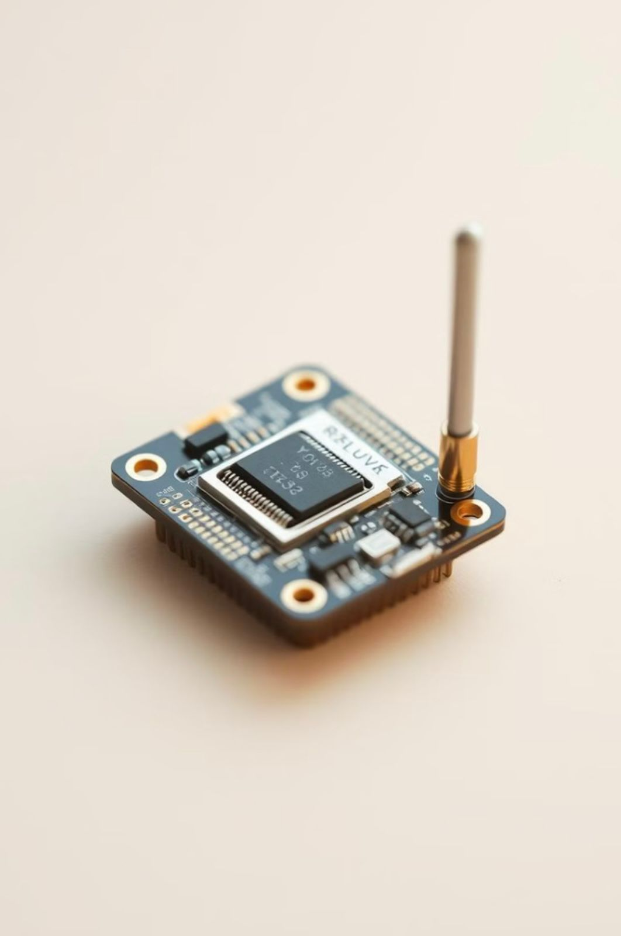




Advantages of WSNs
Cost-Effectiveness
Flexibility
WSNs reduce the need of costly weird infrastructure, thereby becoming a cost-effective solution for various applications.
Their wireless nature allows for easy deployment in challenging or inaccessible environments.
Scalability
Efficiency
WSNs can be easily expanded by adding more sensors nodes to accommodate larger areas or increasing monitoring needs.
WSNs optimize resource utilization, minimize downtime and enhance overall system performance.

Slide 5


Applications of WSNs
Environmental Monitoring
Healthcare
WSNs are crucial for tracking climate change, air, quality and natural disaster detection.
They enable remote patient monitoring, providing rival signs and alerting healthcare providers in emergencies.
Industrial Automation
Smart Cities
WSNs improve efficiency and safety by monitoring machinery, controlling processes and detecting anomalies.
WSNs facilitate smart city applications, such as traffic management, energy efficiency and public safety.

Slide 6


Challenges in WSN Design
1
2
3
Energy Consumption
Scalability
Security
Sensors often run on batteries, so keeping them powered for long periods is a big challenge.
Managing thousands of sensors in large areas can get complicated.
Protecting data from hackers or tempering is critical but tricky, especially with limited resources.

Slide 7

Communication Protocols in WSNs
Common Protocols :
ZigBee, Bluetooth, LoRaWAN and 6LoWPAN.
Factors Influencing Protocol Choice :
Range, Statics Charge, Power Consumption and Community Size.
MAC Protocols :
TDMA and CSMA/CA.

Slide 8

Security in WSNs
Threats :
Eavesdropping, Statistics Tampering and Node Capture.
Security Measures :
Encryption, Authentication and Stable Routing.
Challenges :
Limited computational sources for complex protection algorithms.

Slide 9



Future of WSNs
1
Advanced Sensors
Research focuses on developing extra sophisticated sensors with superior sensing skills and decreased electricity intake.
2
Improved Communication
New communication protocols and technology are being developed to beautify network connectivity.
3
Artificial Intelligence
WSNs are regularly incorporating AI and machine studying to facilitate self-reliant preference-making, predictive modelling and actual-time data assessment.

Slide 10

Conclusion
A Wireless Sensor Network (WSN) consists of distributed sensors that monitor environmental conditions and relay data to a central location. Key components include sensor nodes that collect data, a communication infrastructure and sink/gateway nodes that transmit information. WSN architecture comprises sensing, processing, communication and power units, with various topologies and communication layers. Advantages include cost-effectiveness, scalability and flexibility. WSNs are applied in environmental monitoring, industrial automation, healthcare and smart cities. However, challenges such as energy consumption, scalability and security risks remain significant. Communication protocols like ZigBee and Bluetooth influence performance, while future developments focus on advanced sensors, improved communication technologies, and artificial intelligence to enhance functionality.

